Slide 1
Coronavirus
COVID-19 Analysis
Presenters:
Siddharth Dave Nadia Chenier-Yacoub
Charlene (Shihui) Guo Vaishali Tanwar
Chris Choi

Slide 2
Overview
Core Message and Hypothesis
Understanding COVID-19
Timeline of Virus Spread
Canada and USA as of March 19 2020
Data Sources, Treatment and Analysis approach
Select Country Comparison
Predicting Path for Canada and USA
Conclusion
Q&A

Slide 3
Core Message
The pandemic for COVID-19 is in early stages. It was declared a Pandemic on March 11, 2020
Canada and the US are the latest countries to have number of cases increase significantly after Asia and Europe.
The question posed for the project was: how will Canada and US be like in the next two weeks?
Will Canada and the US be more like China based on actions and rate of the disease spreading?
The hypothesis is how will US and Canada peak and how will the confirmed number of cases will look like.

Slide 4
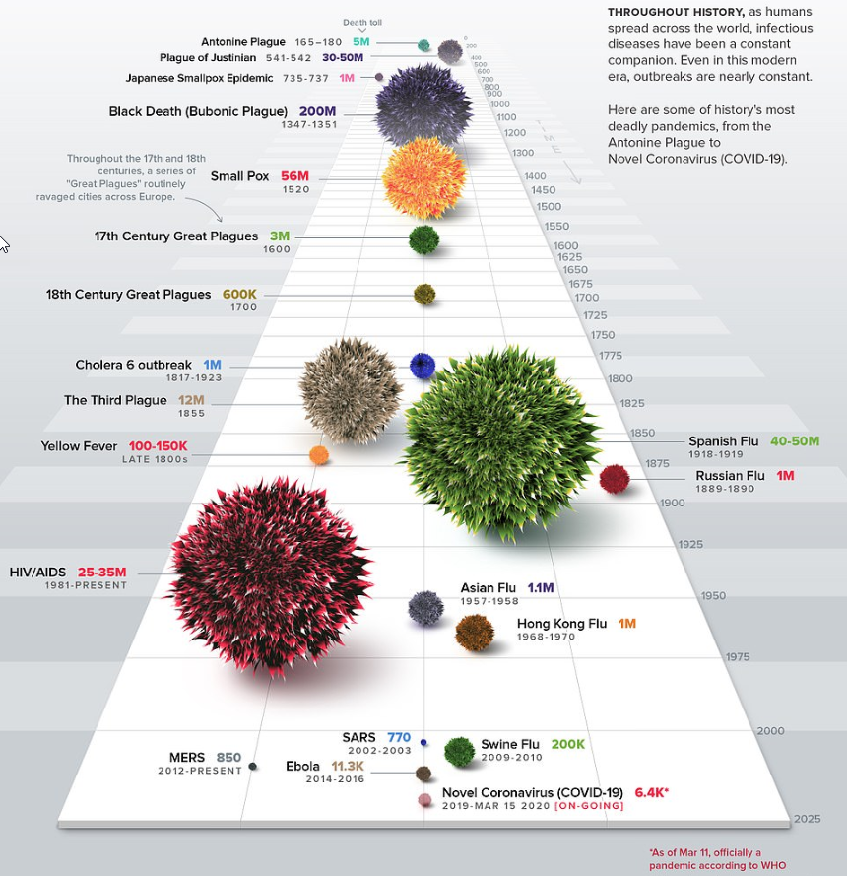
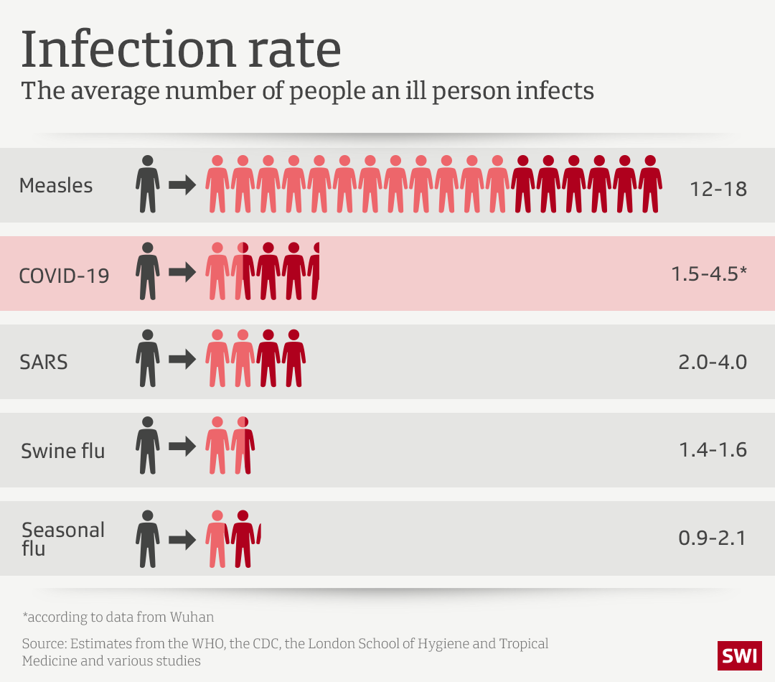
https://www.dailymail.co.uk/news/article-8120631/Visual-timeline-coronavirus-compares-historys-deadly-pandemics.html
Notes:
Many virus infection throughout the human history, more containjs than other virus thugh not less than death report. COVID-19 is an infectious disease caused by a new virus that had not be previously identified in humans.

Slide 5


Slide 6


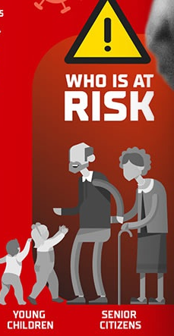
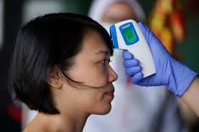
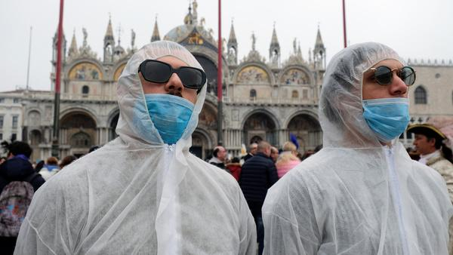

COVID-19 Facts
Notes:
The new coronavirus spreads primarily through contact with infected person when they cough or sneeze, or through droplets of saliva or discharge from the nose.
You can protect yourself by washing your hands frequently and avoiding touching your face.
People may be sick with the virus for 1 to 14 days before developing symptoms. The virus causes respiratory illness (similar to flu) with symptoms such as cough, fever, and in more severe cases, pneumonia. Most people (about 80%) recover from the disease without needing special treatment.
More rarely, the disease can be serious and even fatal. Older people, and people with other medical conditions may be more vulnerable to becoming severely ill.

Slide 7
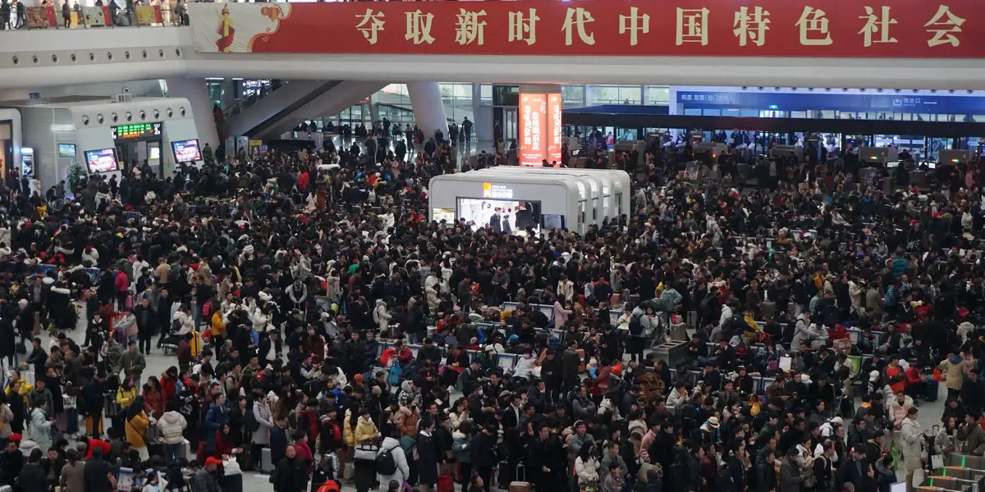
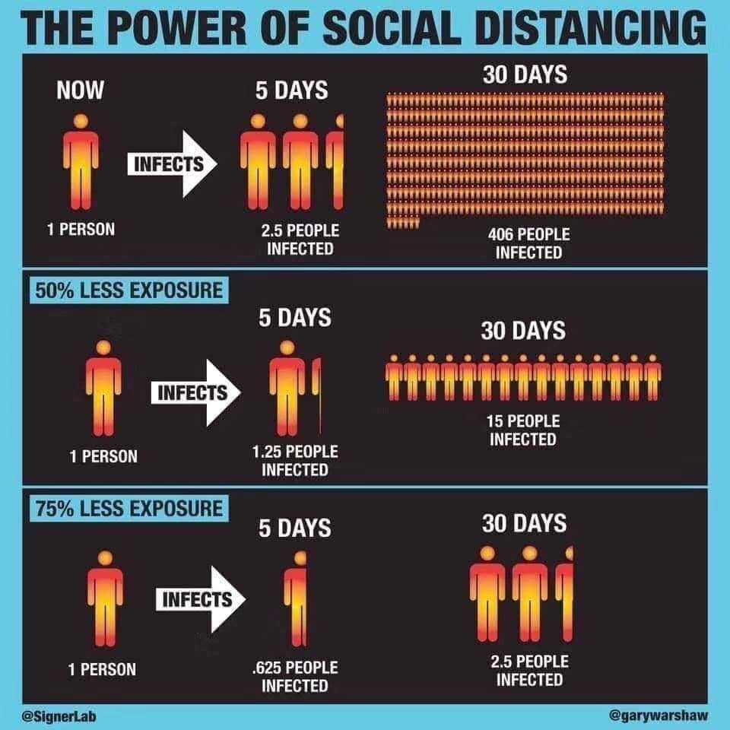
Notes:
The new coronavirus spreads primarily through contact with infected person when they cough or sneeze, or through droplets of saliva or discharge from the nose.
You can protect yourself by washing your hands frequently and avoiding touching your face.
People may be sick with the virus for 1 to 14 days before developing symptoms. The virus causes respiratory illness (similar to flu) with symptoms such as cough, fever, and in more severe cases, pneumonia. Most people (about 80%) recover from the disease without needing special treatment.
More rarely, the disease can be serious and even fatal. Older people, and people with other medical conditions may be more vulnerable to becoming severely ill.

Slide 8

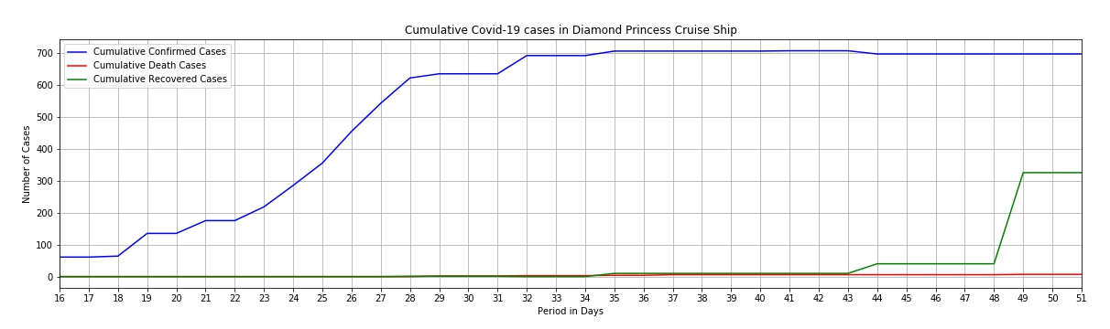
DIAMOND PRINCESS

Slide 9
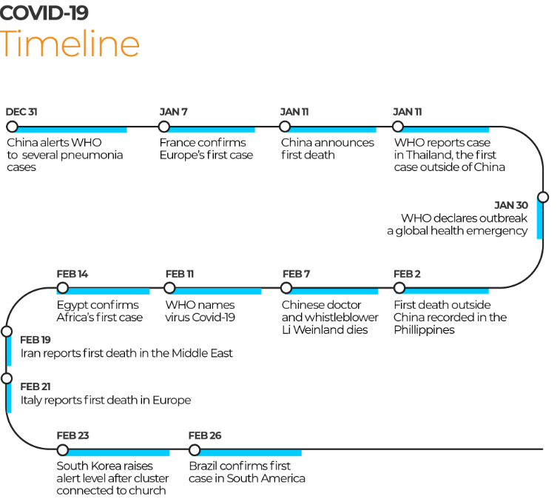
March 11 WHO declares COVID-19 a Pandemic

Slide 10
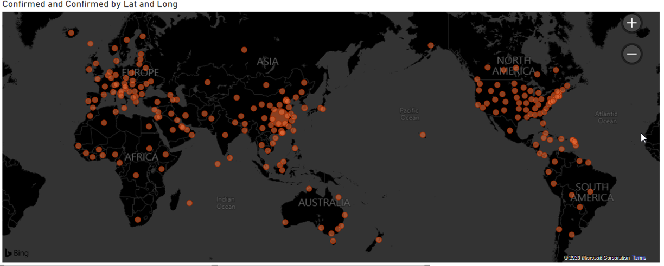
Confirmed cases as of March 13
https://drive.google.com/drive/my-drive
Notes:
Early 2020, a new virus spreaded in the wuhan province of China. Despict the sever actions taken by the chinese government, the virus was not contained within the epi center, soon spreaded across the globe. The spread is rapidly evolving at the rest of the world, ie. Italy, Iran, South Korea, US, and Canda. This is a global health crisis, and we would like to know when the virus will hit north America with over-whelming cases.

Slide 11
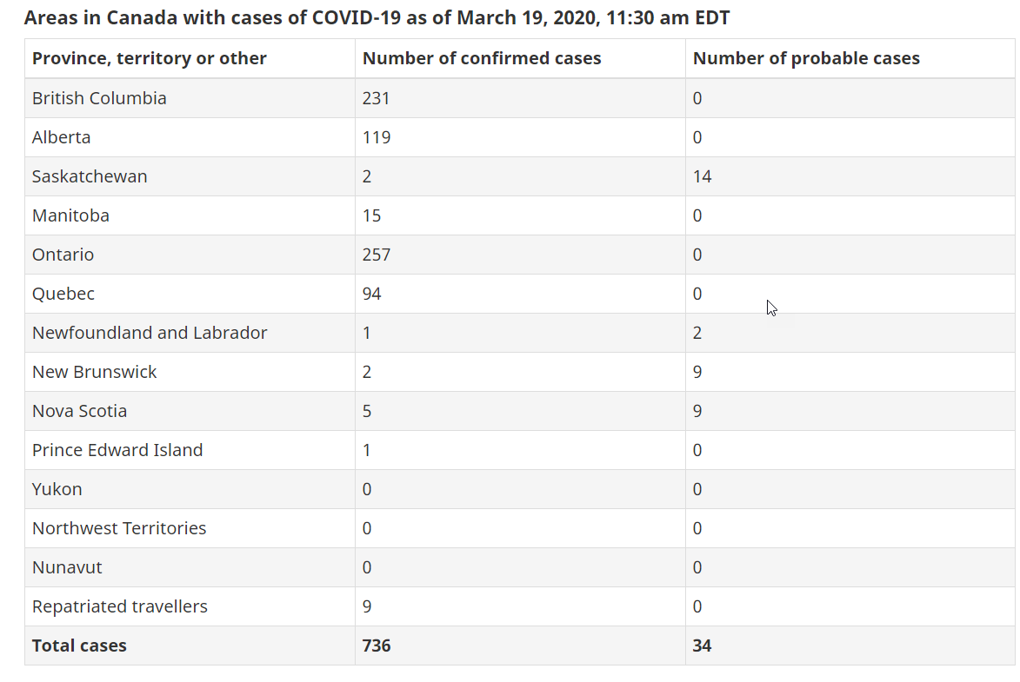
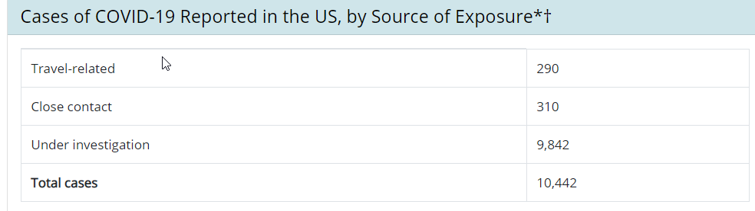
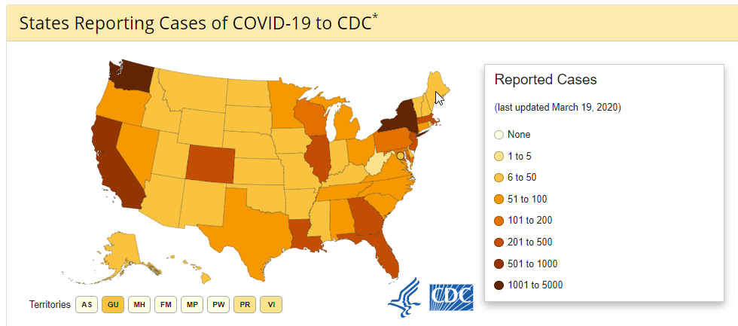
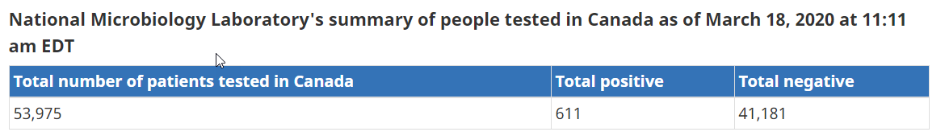

Slide 12
DATA SOURCES
2019 Novel Coronavirus COVID-19 (2019-nCoV) Data Repository by Johns Hopkins CSSE
https://github.com/CSSEGISandData/COVID-19.git
The Github and data Repository by John Hopkins CSSE pulled the data from the following sources
World Health Organization (WHO): https://www.who.int/
DXY.cn. Pneumonia. 2020. http://3g.dxy.cn/newh5/view/pneumonia.
BNO News: https://bnonews.com/index.php/2020/02/the-latest-coronavirus-cases/
National Health Commission of the People’s Republic of China (NHC): http://www.nhc.gov.cn/xcs/yqtb/list_gzbd.shtml
China CDC (CCDC): http://weekly.chinacdc.cn/news/TrackingtheEpidemic.htm
Hong Kong Department of Health: https://www.chp.gov.hk/en/features/102465.html
Macau Government: https://www.ssm.gov.mo/portal/
Taiwan CDC: https://sites.google.com/cdc.gov.tw/2019ncov/taiwan?authuser=0
US CDC: https://www.cdc.gov/coronavirus/2019-ncov/index.html
Government of Canada: https://www.canada.ca/en/public-health/services/diseases/coronavirus.html
Australia Government Department of Health: https://www.health.gov.au/news/coronavirus-update-at-a-glance
European Centre for Disease Prevention and Control (ECDC): https://www.ecdc.europa.eu/en/geographical-distribution-2019-ncov-cases
Ministry of Health Singapore (MOH): https://www.moh.gov.sg/covid-19
Italy Ministry of Health: http://www.salute.gov.it/nuovocoronavirus
Notes:
They have compiled the data from the following sources:
World Health Organization (WHO): https://www.who.int/
DXY.cn. Pneumonia. 2020. http://3g.dxy.cn/newh5/view/pneumonia.
BNO News: https://bnonews.com/index.php/2020/02/the-latest-coronavirus-cases/
National Health Commission of the People’s Republic of China (NHC): http://www.nhc.gov.cn/xcs/yqtb/list_gzbd.shtml
China CDC (CCDC): http://weekly.chinacdc.cn/news/TrackingtheEpidemic.htm
Hong Kong Department of Health: https://www.chp.gov.hk/en/features/102465.html
Macau Government: https://www.ssm.gov.mo/portal/
Taiwan CDC: https://sites.google.com/cdc.gov.tw/2019ncov/taiwan?authuser=0
US CDC: https://www.cdc.gov/coronavirus/2019-ncov/index.html
Government of Canada: https://www.canada.ca/en/public-health/services/diseases/coronavirus.html
Australia Government Department of Health: https://www.health.gov.au/news/coronavirus-update-at-a-glance
European Centre for Disease Prevention and Control (ECDC): https://www.ecdc.europa.eu/en/geographical-distribution-2019-ncov-cases
Ministry of Health Singapore (MOH): https://www.moh.gov.sg/covid-19
Italy Ministry of Health: http://www.salute.gov.it/nuovocoronavirus

Slide 13
DATA EXPLORATION AND CLEANING
Read the required .csv files into pandas dataframes.
Cleaned the data frames by dropping the columns that were not required as well as filling the NaN values with zeros in order to perform mathematical calculations
Grouped the data frames by country/region and performed a sum on the grouped data frame in order to obtain cumulative number of confirmed , death and recovered cases for each country/region for a period of 52 days from 22 January,2020 till 13 March,2020.

Slide 14
ANALYSIS PROCESS
Using the cleaned dataset, information was extracted for 9 different countries namely China, Iran, Italy, South Korea, Japan , Singapore, US and Canada to carry out further investigation and identifying patterns.
For each of these countries data was analysed in terms of the number of confirmed, death and recovered cases using graphs, plotted using matplotlib library and also compared all of these countries in terms of death percentage, recovered percentage , speed of infection and infection rate.
ARIMA model in Python which is a time series analysis was used to predict the spread of COVID-19 in Canada and the US using China as the training data.
Notes:
Describe the analysis process
All
Processing the data using panda, numpy, statistics, matplotlib (all)
Libary to build Arema model (sid)
Library to build animaated map (Nadia)

Slide 15
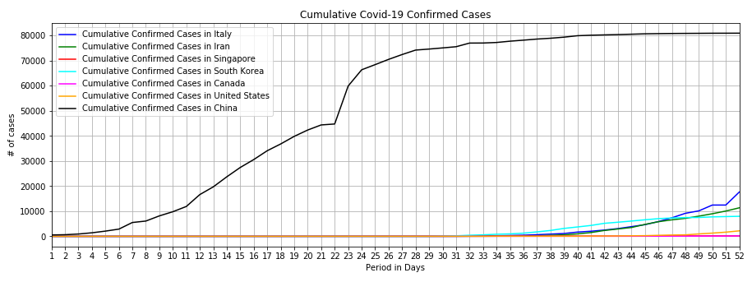
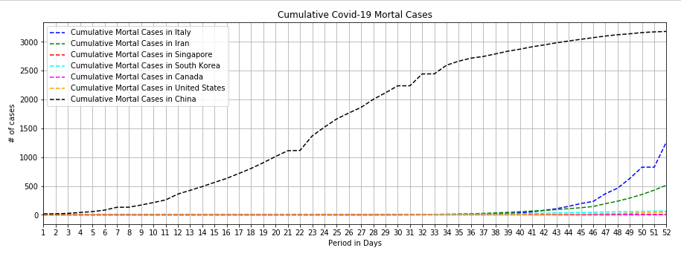
The first day of the record is 22nd Jan. China, South Korea, Japan and the US were already reporting confirmed cases.
The next day, 23rd Jan, first confirmed case in Singapore.
26th Jan, first confirmed case in Canada.
31st Jan, first confirmed case reported in Italy.
29th Feb, first confirmed case in Iran

Slide 16
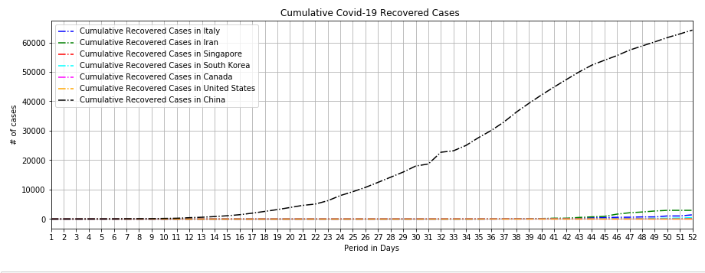
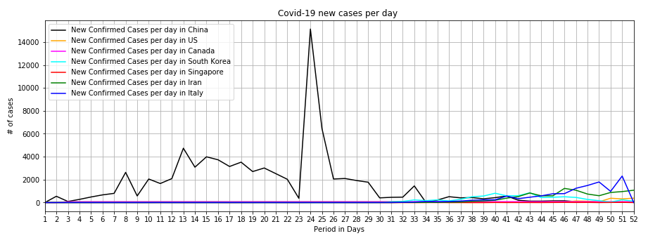
Notable Events:
Day 23 (February 13th) political fallout in China. Former governor of the Hubei province (Wuhan is the capital of Hubei Province) was replaced a few days prior. New governor was installed to conduct more aggressive vetting procedures.
Days 24,25. New policies implemented to seal off buildings and residential area in Shiyan (a city in Hubei). Schools in Hong Kong were announced to remain closed until late March
Day 47. Italy officially put the country under quarantine measures

Slide 17
Project objective
Prediction of the COVID-19 surge in US and Canada?

Slide 18
COVID-19 in China, US and Canada
 | China | US | Canada
Patient Zero | Nov 17th, 2019 | Jan 22nd, 2020 | Jan 26th, 2020
Cases on 22nd Jan | 528 | 1 | 0
Cases Today | 80,928 | 11,348 | 770
Notes:
From these numbers, you can say that there is pattern here. Countries go through 4 stages of dealing with the spread of the virus: Denial, Admission, Panic & Action. China didn't take the spread of the virus seriously from Nov to end of Dec 2019 and when it realized that this is close to an epidemic, they had to take swift action to contain it. Thus you can see that within 4 months, more than 80k people were infected by the virus. US went through some similar pattern, they neglected seriousness until Jan end and it is evident that within 2 months of first confirm virus, the number is at more than 11k. Canada on the other are able to contain the numbers thus far but very swift action are needed to control this number.
It is very difficult to predict number of cases that might emerge in the near future without knowing a confirmed Rnaught number. So, in order to predict the number of future cases for US and Canada, we looked at the worst case scenario in hand: CHINA and we applied ARIMA modelling technique to predict the number of cases in the next 2 weeks.

Slide 19
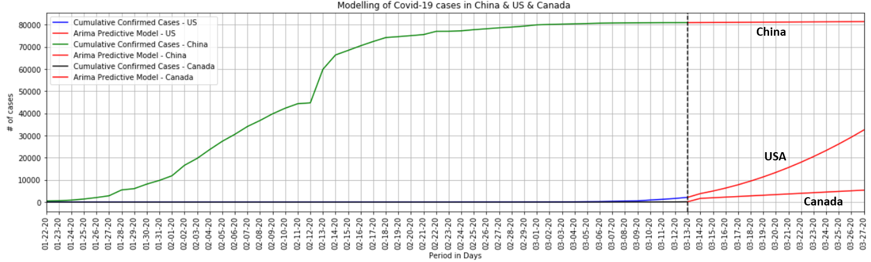
AutoRegressive Integrated Moving Average - ARIMA
Total confirmed cases in US: 11,348 | Per ARIMA model: 11,369
Total confirmed cases in Canada: 770 | Per ARIMA model: 3121
As of 19th March 2020
https://www.worldometers.info/coronaviru/
Notes:
Please consider that we analyzed the data from 22nd Jan to 13th March to predict the numbers of US and Canada until 27th March (2 weeks).
Using AutoRegressive Integrated Moving Average Analysis - ARIMA time series analysis, we were able to predict some numbers of US and Canada.
As you can see from the model, the prediction for total cases up until today for US is 11,369 and actual cases confirmed thus far is 11,348. Not bad for a first timer playing with this modelling technique.
For Canada, the prediction says today we should have 3,121 cases but thus far we only have 770. I think Canadian officials are doing something effective here.
As you can see from the China data thus far, it is evident that its plateaued now, infact as per the news today China reported zero cases after about 4 months into this pandemic.
US and Canada need to restrict movements of people and everyone needs to do their fair share to not spread the virus as much as possible.

Slide 20



What will North America like in 2 weeks
US: 32,552
Canada: 5,409
Everyone will have a part to play here, so…..

Slide 21


Thank you.
And please don’t hoard toilet paper. Thank you again.

